Slide 1
Pain Scale
Aphasia-friendly toolkit March 2024
Disclaimer: These materials were created using funding from the Provincial Community Stroke Rehabilitation Initiative and crafted by Aran Oberle, Speech Language Pathologist, with input from regional rehab programs. They are not meant to replace professional expertise. Readers should seek advice from a qualified healthcare provider for any concerns. The content of this PowerPoint can be adjusted to suit the needs of healthcare professionals. Users are accountable for confirming the accuracy and suitability of the information for their unique situations.

Slide 2
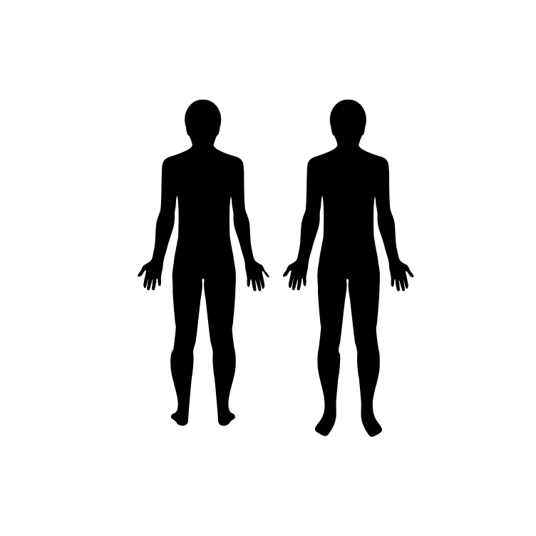
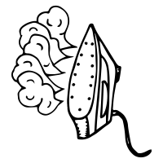
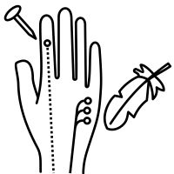
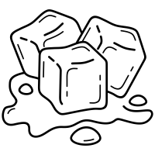
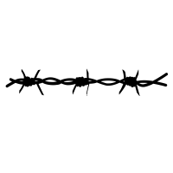
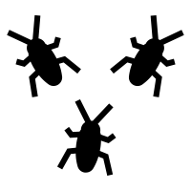
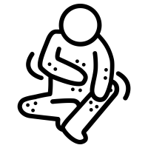
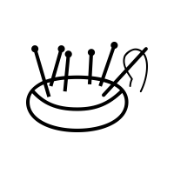
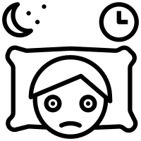
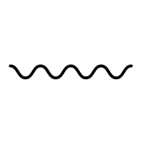
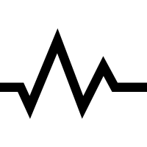
Where?
PAIN
Front
Back
What type?
Cold | Hot | Burn | Numb
Stab | Piercing | Pinch | Cramp Spasm
Barbed Wire | Crawling | Pins and Needles | Itchy
Shock | Sharp | Dull | Keeps Me Awake
On and off | Constant | Throbbing
How much?
0
No Pain
1
2
Mild
3
5
6
Severe
7
9
10
Worst Pain Possible
4
Moderate
8
Very Severe

Slide 3
DOULEUR
Où?
Avant
Arrière
Quel type?
Froid | Chaud | Brûlement | Engourdie
Lancinante | Perçante | Pincement | Crampe
Fil de fer barbelé | Fourmille-ments | Picotement | Démange -aison
Spasme Choc | Aiguë | Sourde | Me garde Éveillé
Intermittent | Continue | Pulsatile
Combien?
2
Léger
6
Sevère
7
9
0
Pas de douleur
1
3
8
Très
sevère
4
Modéré
5
10
Pire douleurpossible

Slide 4
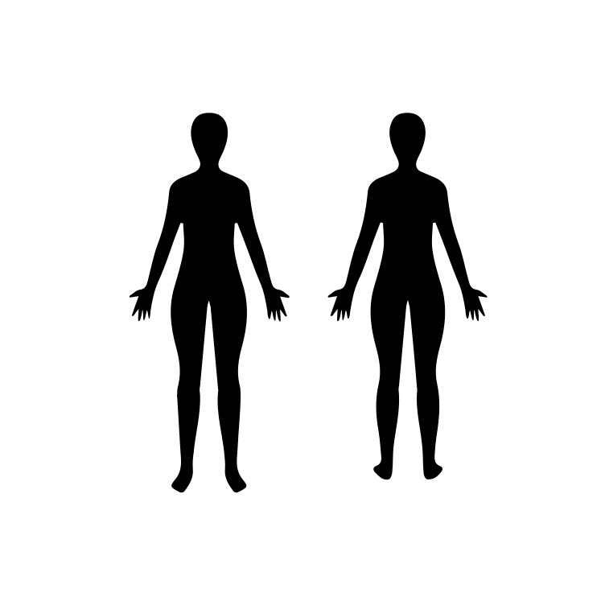
PAIN
Where?
Front
Back
What type?
Cold | Hot | Burn | Numb
Stab | Pierce | Pinch | Cramp Spasm
Barbed Wire | Crawling | Pins and Needles | Itchy
Shock | Sharp | Dull | Keeps Me Awake
On and off | Constant | Throbbing
How much?
2
Mild
6
Severe
7
9
0
No Pain
1
3
8
Very Severe
4
Moderate
5
10
Worst Pain Possible

Slide 5
DOULEUR
Où?
Avant
Arrière
Quel type?
Froid | Chaud | Brûlement | Engourdie
Lancinante | Perçante | Pincement | Crampe
Fil de fer barbelé | Fourmille-ments | Picotement | Démange -aison
Spasme Choc | Aiguë | Sourde | Me garde Éveillé
Intermittent | Continue | Pulsatile
Combien?
2
Léger
6
Sevère
7
9
0
Pas de douleur
1
3
8
Très
sevère
4
Modéré
5
10
Pire douleurpossible

Slide 6
PAIN
Where?
Front
Back
How much?
0
No Pain
10
Worst Pain Possible
1
2
Mild
3
5
6
Severe
7
9
4
Moderate
8
Very Severe

Slide 7
PAIN
What type?
Cold | Hot | Burn | Numb
Stab | Piercing | Pinch | Cramp Spasm
Barbed Wire | Crawling | Pins and Needles | Itchy
Shock | Sharp | Dull | Keeps Me Awake
On and off | Constant | Throbbing

Slide 8
PAIN
Where?
Front
Back
How much?
0
No Pain
10
Worst Pain Possible
1
2
Mild
3
5
6
Severe
7
9
4
Moderate
8
Very Severe

Slide 9
PAIN
What type?
Cold | Hot | Burn | Numb
Stab | Piercing | Pinch | Cramp Spasm
Barbed Wire | Crawling | Pins and Needles | Itchy
Shock | Sharp | Dull | Keeps Me Awake
On and off | Constant | Throbbing

Slide 10
DOULEUR
Où?
Avant
Arrière
Combien?
2
Léger
6
Sevère
7
9
0
Pas de douleur
1
3
8
Très
sevère
4
Modéré
5
10
Pire douleurpossible

Slide 11
DOULEUR
Quel type?
Froid | Chaud | Brûlement | Engourdie
Lancinante | Perçante | Pincement | Crampe
Fil de fer barbelé | Fourmille-ments | Picotement | Démange -aison
Spasme Choc | Aiguë | Sourde | Me garde Éveillé
Intermittent | Continue | Pulsatile

Slide 12
DOULEUR
Où?
Avant
Arrière
Combien?
2
Léger
6
Sevère
7
9
0
Pas de douleur
1
3
8
Très
sevère
4
Modéré
5
10
Pire douleurpossible

Slide 13
DOULEUR
Quel type?
Froid | Chaud | Brûlement | Engourdie
Lancinante | Perçante | Pincement | Crampe
Fil de fer barbelé | Fourmille-ments | Picotement | Démange -aison
Spasme Choc | Aiguë | Sourde | Me garde Éveillé
Intermittent | Continue | Pulsatile

