Slide 1
Inpatient Goal Status Tracking Signs
Document | Slide
Transfers Walking/Ambulation Stairs | EN: 2 FR: 7
Bathing Dressing Toileting | EN: 3 FR: 8
Safety at home alone Managing Medications Cooking Finances | EN: 4 FR: 9
Speaking Listening Reading/Writing Cognitive-linguistic skills | EN: 5 FR: 10
Swallow strategies | EN: 6 FR: 11

Slide 2
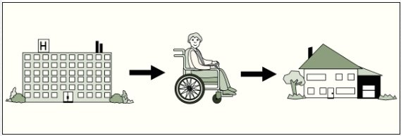
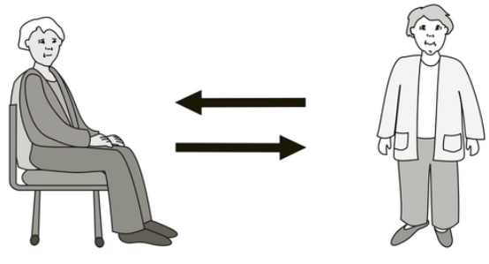
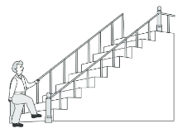
Our GOALS for discharge from hospital.
Goals may change
TRANSFERS
Independent
Supervision
Assistance from ______ person(s)
Too early to predict
_________________________________________
WALKING / AMBULATION
Independent
Supervision
Assistance from ______ person(s)
Too early to predict
_________________________________________
STAIRS
Independent
Supervision
Assistance from ______ person(s)
Too early to predict
_________________________________________
Images used are from ParticiPics – a free, searchable database of pictographic images developed by the Aphasia Institute, ​https://www.aphasia.ca/participics

Slide 3
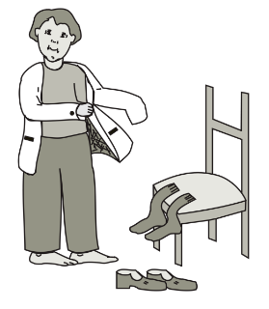
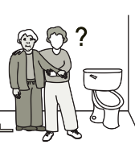
Our GOALS for discharge from hospital.
Goals may change
BATHING
Sink Shower
Assistive devices
Independent
Assistance from ______ person(s)
______________________________________________
DRESSING
Assistive devices
Independent
Assistance from ______ person(s)
______________________________________________
TOILETING
Assistive devices
May need incontinence care
Independent
Assistance from ______ person(s)
______________________________________________
Images used are from ParticiPics – a free, searchable database of pictographic images developed by the Aphasia Institute, ​https://www.aphasia.ca/participics

Slide 4
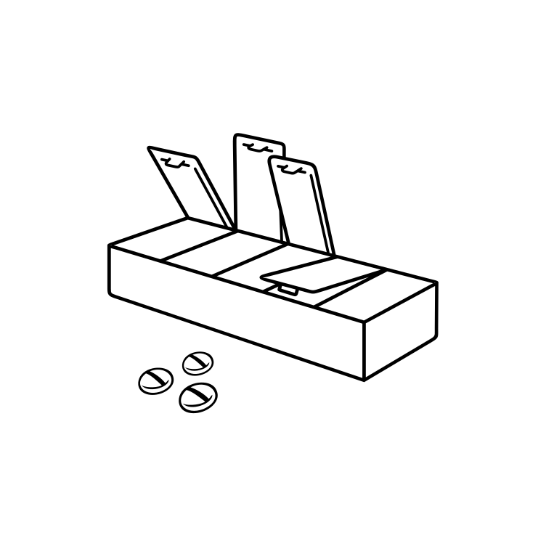
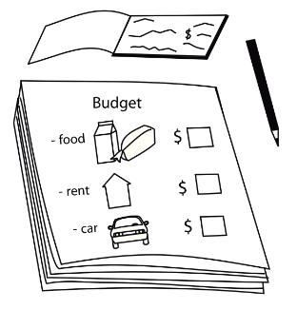
Our GOALS for discharge from hospital.
Goals may change
SAFETY AT HOME ALONE:
Likely safe
Likely unsafe:__________________________
Too early to predict
MANAGING MEDICATIONS
Likely to need assistance
Likely to manage independently
Too early to predict
COOKING
Likely to need assistance
Likely to manage independently
Too early to predict
FINANCES
Likely to need assistance
Likely to manage independently
Too early to predict
Images used are from ParticiPics – a free, searchable database of pictographic images developed by the Aphasia Institute, ​https://www.aphasia.ca/participics

Slide 5
Our GOALS for discharge from hospital.
Goals may change
SPEAKING
Independent
Words Phrases Sentences
Strategies:________________________________
LISTENING
Independent
Words Phrases Sentences
Strategies:________________________________
READING
Independent
Words Phrases Sentences
Strategies:________________________________
WRITING
Independent
Words Phrases Sentences
Strategies:________________________________
Independent Assistance
Strategies:________________________________
COGNITIVE-LINGUISTIC SKILLS
Images used are from ParticiPics – a free, searchable database of pictographic images developed by the Aphasia Institute, ​https://www.aphasia.ca/participics

Slide 6
Swallow Strategies
Questions? ​​

Slide 7
Nos OBJECTIFS pour la sortie de l'hôpital.
Les objectifs peuvent changer
TRANSFERTS
Indépendent
Supervision
Assistance de ______ personne(s)
Trop tôt pour prévoir
_________________________________________
MARCHER / AMBULATION
Indépendent
Supervision
Assistance de ______ personne(s)
Trop tôt pour prévoir
_________________________________________
ESCALIERS
Indépendent
Supervision
Assistance de ______ personne(s)
Trop tôt pour prévoir
_________________________________________
Images used are from ParticiPics – a free, searchable database of pictographic images developed by the Aphasia Institute, ​https://www.aphasia.ca/participics

Slide 8
Nos OBJECTIFS pour la sortie de l'hôpital.
Les objectifs peuvent changer
SE LAVER
Lavabo Douche
Équipement d'assistance
Indépendent
Assistance de ______ personne(s)
______________________________________________
S'HABILLER
Équipement d'assistance
Indépendent
Assistance de ______ personne(s)
______________________________________________
TOILETTE
Équipement d'assistance
Peut avoir besoin de soins d'incontinence
Indépendent
Assistance de ______ personne(s)
______________________________________________
Images used are from ParticiPics – a free, searchable database of pictographic images developed by the Aphasia Institute, ​https://www.aphasia.ca/participics

Slide 9
Nos OBJECTIFS pour la sortie de l'hôpital.
Les objectifs peuvent changer
SÉCURITÉ À LA MAISON SEUL:
Probablement sécuritaire
Probablement à risque:__________________
Trop tôt pour prédire
GESTION DES MÉDICAMENTS
Avoir besoin d'aide
Se débrouiller seul
Trop tôt pour prédire
CUISINER
Avoir besoin d'aide
Se débrouiller seul
Trop tôt pour prédire
FINANCES
Avoir besoin d'aide
Se débrouiller seul
Trop tôt pour prédire
Images used are from ParticiPics – a free, searchable database of pictographic images developed by the Aphasia Institute, ​https://www.aphasia.ca/participics

Slide 10
Nos OBJECTIFS pour la sortie de l'hôpital.
Les objectifs peuvent changer
PARLER
Indépendent
Mots Phrases courtes Phrases longues
Stratégies:________________________________
ÉCOUTER
Indépendent
Mots Phrases courtes Phrases longues
Stratégies:________________________________
LIRE
Indépendent
Mots Phrases courtes Phrases longues
Stratégies:________________________________
ÉCRIRE
Indépendent
Mots Phrases courtes Phrases longues
Stratégies:________________________________
Indépendent Assistance
Stratégies:________________________________
HABILETÉS COGNITIVOLINGUISTIQUES
Images used are from ParticiPics – a free, searchable database of pictographic images developed by the Aphasia Institute, ​https://www.aphasia.ca/participics

Slide 11
Stratégies de déglutition
Questions? ​​

